Slide 1
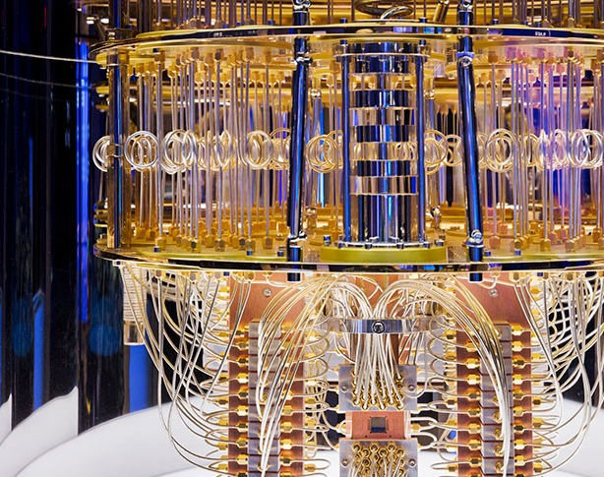
Quantum Computing The Race for Global Supremacy
James Kroll
Computer Science & Information Systems
Senior Capstone Seminar
Spring 2022
Photo Provided by: IBM, 2021

Slide 2
Definitions
Quantum Mechanics – a theory of matter that is based on the concept of the possession of wave properties by elementary particles, that affords a mathematical interpretation of the structure and interactions of matter on the basis of these properties, and that incorporates within it quantum theory and the uncertainty principle
Quantum Theory – a theory in physics based on the concept of the subdivision of radiant energy into finite quanta and applied to numerous processes involving transference or transformation of energy in an atomic or molecular scale
Uncertainty Principle - a principle in quantum mechanics: it is impossible to discern simultaneously and with high accuracy both the position and the momentum of a particle (such as an electron)
Quantum Entanglement – a property of a set of subatomic particles whereby a quantum characteristic (such as spin or momentum) of one particle is directly and immediately correlated with the equivalent characteristic of the others regardless of separation in space
Qubit - a unit of computing information that is represented by a state of an atom or elementary particle (such as the spin) and can store multiple values at once due to the principles of quantum mechanics. Figure 2 provides a visually depiction of classical bit vs qubit.
Quantum Computing - a computer that takes advantage of the quantum properties of qubits to perform certain types of calculation extremely quickly compared to conventional computers
All definitions have been obtained from Merriam-Webster.com

Slide 3
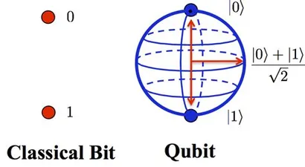
Figure 2
Image provided by: IEEE Explore journal article

Slide 4
Hardware
Quantum Computing requires specific hardware in a controlled environment in order to operate effectively.
Current technology allows quantum components in isolation to work in tandem with classical computers to complete its computations, as illustrated in figure 3.
Quantum Reversible Gate – a gate that allows the input to be manipulated, based on observing the output because quantum operations are unitary in design.
Quantum Register – q designated set of qubits that holds all the possible combinations, based on input. An n-qubit register hold 2^n possible combinations simultaneously
Quantum Processing Unit – working on the properties of quantum mechanics, it requires RAM (Logic Gates + Register), a quantum control unit, and quantum transistors. The QPU sends its data back through the control unit which communicates with the classical computer, and eventually the end user.
All quantum components are housed in a vacuum sealed and typically refrigerated environment.
Most research is conducted at 1 K, this is required to stabilize and maintain the coherence of the qubits.
Recent research has discovered qubit coherence in a room temperature environment.

Slide 5
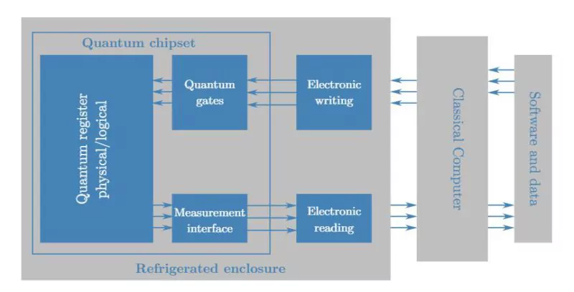
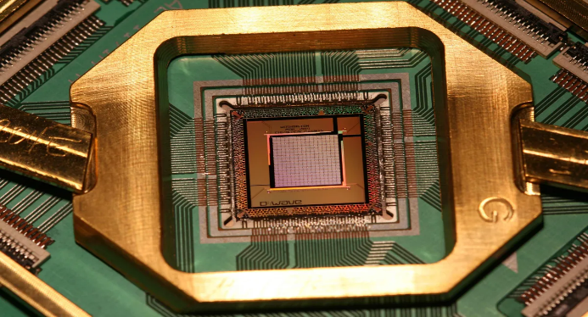
Figures 3 & 4
Figure 4: Depicts Google & D-Wave’s quantum processor.
Photo Provided by: (Quantum Processor, n.d.)
Figure 3: Depicts the interaction between quantum computing components and classical computers.
Photo Provided by: IEEE Explore journal article

Slide 6
Modern Approaches
Photonics – uses individual photons to transmit information. Having a weak interaction with the environment around them, photons exhibit a natural isolation property. Their weak interactions allows for accurate qubit representation while in a room temperature environment. Has the advantage of compatible integration with fiber optic-based infrastructure.
Trapped Ions – the process requiring a steel vacuum chamber cooled down to 1K, or nearly -450 F, using multiple lasers to chip individual electrons away from the atom, ionizing it. Electrodes are used to generate an electric field that captures those ions.
Semiconducting Material - a process that simulates electrons in materials such as germanium, diamonds, selenium, or silicon carbide. Through the application of microwaves and magnetic fields, the materials begin to exhibit quantum properties, including superposition and entanglement. Operating near 0.1 K, semiconducting material made strides in 2020, when they achieved coherent results at 1.5 K
Superconducting Material – a process that uses microwaves along with low-frequency electrical signals. The signals are transmitted through wires and supercooled before reaching the qubits in the controlled environment.
All descriptions have been obtained from (Hajjar, 2022a)

Slide 7
Benefits
The ability to crunch massive amounts of data. CERN outputs 1 petabyte of data per second while in operation. CERN has partnered with and join the IBM quantum network and with a fleet of 23 quantum machines they replace the nearly 1 million CPUs at 170 locations around the world that was used prior.
The simulation capabilities of a quantum computer will be able to advance our knowledge about the origin of the universe while mapping out the known universe, advance nuclear fusion research, further climate change research, expedite drug and vaccine trials, and it could be the secret to unlocking AI consciousness.
Additionally, it is theorized that quantum simulations may remove the need altogether for physical lab testing in many industries as it could replicate the experiment thousands of times much faster than we could finish a single trial.
Had we lived in a quantum computing age during the COVID-19 pandemic, a vaccine could have been developed in a matter of days, which may have drastically changed the landscape of that time.
Network security becomes a lot harder to crack with quantum encryption. Some companies and governments have been exploring upgrading to quantum encryption. It is theorized that a hacker using quantum components would break the public key encryption system we rely on so heavily today.

Slide 8
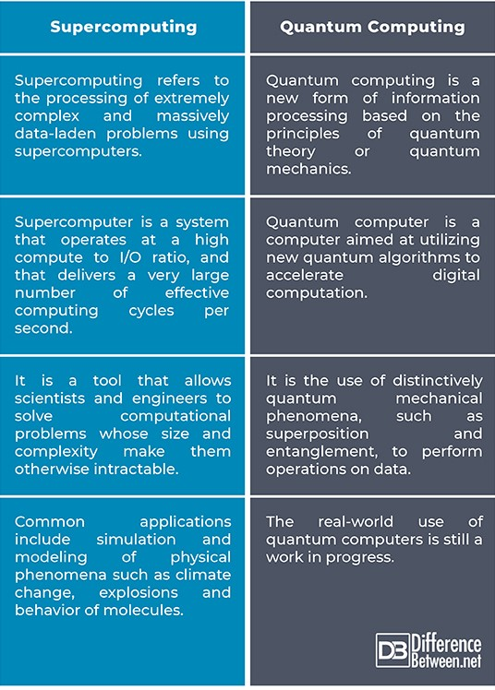
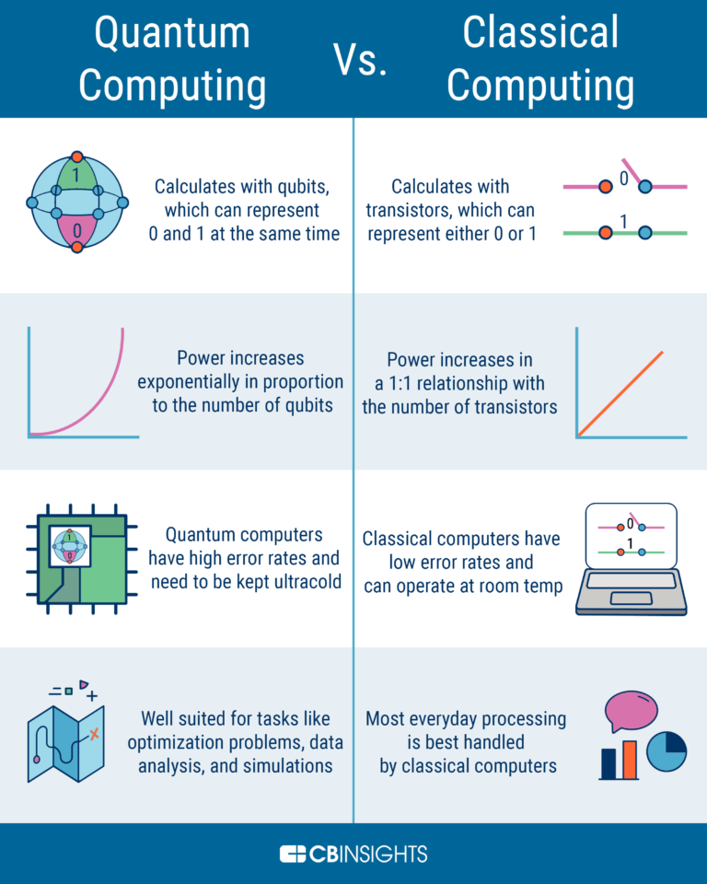
Quantum vs Super vs Classical Computers
Figure 5: Chart depicting the differences between supercomputers and quantum computers.
Photo Provided by: Supercomputing vs Quantum Computing, 2021)
Figure 6: depicting the benefits and challenges of quantum computers vs classical (digital) computers.
Photo Provided by:(Quantum Computing vs Digital Computing, 2021

Slide 9
Challenges
We have only entered the toddler phase of Quantum research and although research teams are making discoveries at a rate unheard of 20 years ago, a lot of those discoveries are hard to repeat, some of which only experiencing a 1/10 rate of consistency. Although that is amazing in terms of conceptual understanding, it means we are far from implementing these discoveries into everyday life.
The current operational climate for quantum computers is not ideal. Photonics gave us a breakthrough that will help make quantum research more operational.
The cost for current research/discovery ratio is extremely high.
Similar to fusion with the idea that “true quantum computing” is still decades off.
Quantum computers are currently highly specialized to the desires of each research goal. A lot of the discoveries from one team’s machine are difficult to replicate for other teams on their own machines.
Although this has gotten better since the Quantum Initiative was signed, a lack of funding will always be a detriment to research.
Most countries still do not possess their own infrastructure which causes delays in their research.

Slide 10
Quantum Initiative
In 2018 the United States government signed into law the National Quantum Initiative Act, establishing the goals and funding for a 10-year plan.
In 2017 China began construction on their national laboratory, which later created the Jiuzhang prototype quantum computer. In their 14th 5-year plan (2021-2025), China has agreed to dedicate $10 billion towards gaining quantum supremacy.

Slide 11
Quantum Initiative continued

Slide 12
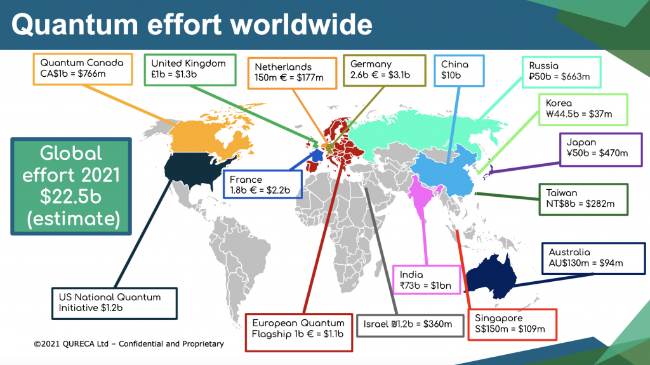

Slide 13
History

Slide 14
Modern Research

Slide 15
Commercialization

Slide 16
Final Thoughts

